Slide 1
USING ADC IN ATMEGA32
CSE 315
Courtesy: Muhammad Ali Nayeem, Azad Abdus Salam, Md. Iftekharul Islam Sakib

Slide 2
LEARNING OBJECTIVE
Why do we need ADC?
What is ADC?
ADC in ATmega32
A simple example

Slide 3
RECAP
MCU is a digital processor
Works with binary data
Just 2 voltage levels
MCU needs to collect information from the real world
Temperature, Pressure, Humidity, Sound …
Continuous property
Infinite possible values
Why do we collect information?
To analyze the situation
To take appropriate actions

Slide 4
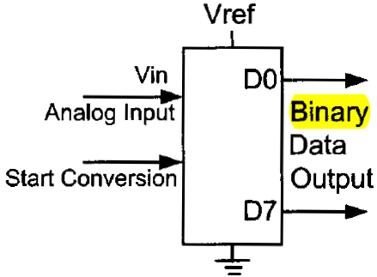
RECAP
But how to collect information?
Sensors: Convert physical property into analog signal
Voltage, Current, Resistance, …
How can MCU recognize these signal?
Need to convert into digital data
How?
Approximation
Need something special!

Slide 5
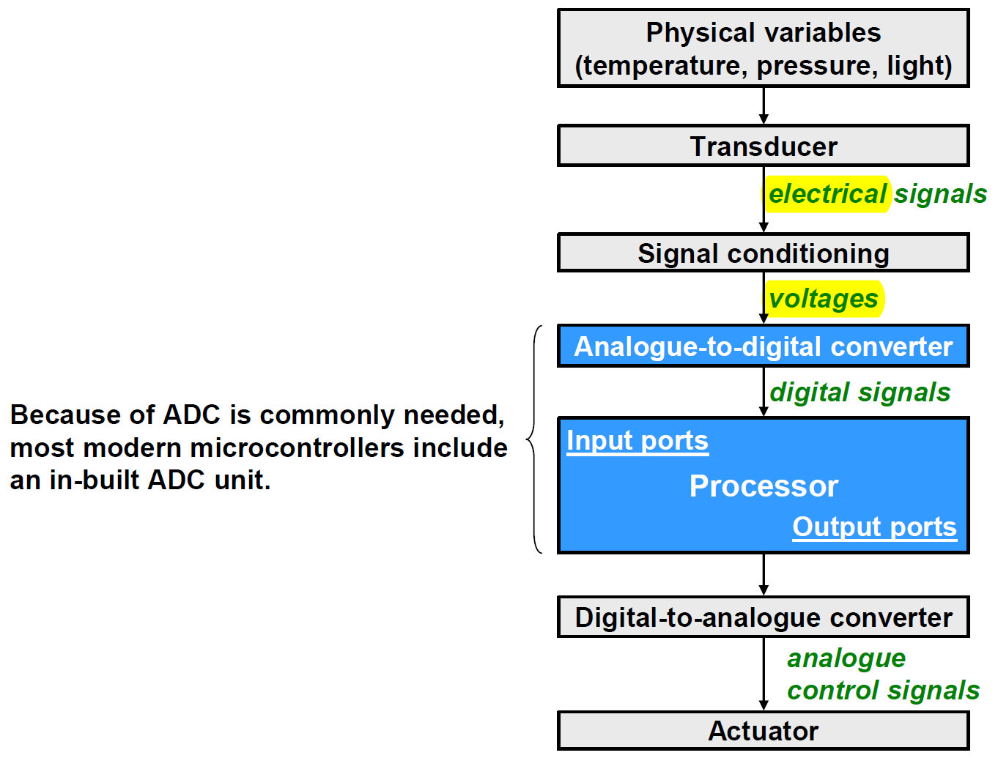
TYPICAL EMBEDDED APPLICATION

Slide 6
ADC: QUICK REVIEW

Slide 7
A-TO-D CONVERSION
Two related steps
Sampling (Approximating the X-axis)
the analogue signal is extracted at regularly spaced time instants
the samples have real values
Quantization (Approximating the Y-axis)
the samples are quantized to discrete levels
each sample is represented as a binary value

Slide 8
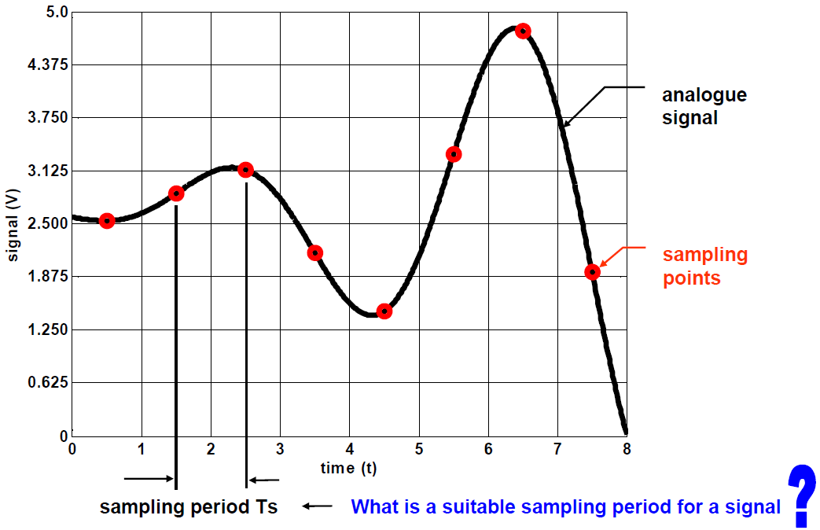
SAMPLING AN ANALOGUE SIGNAL

Slide 9
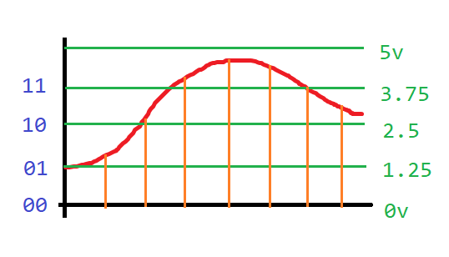
QUANTIZING THE SAMPLED SIGNAL
How many bit to represent the analogue value?
Say, 2 bit to represent analogue value from 0V to 5V
Step size = 5V / 2^2 = 5V / 4 = 1.25V
Digital value = floor(Analogue value / 1.25V)

Slide 10
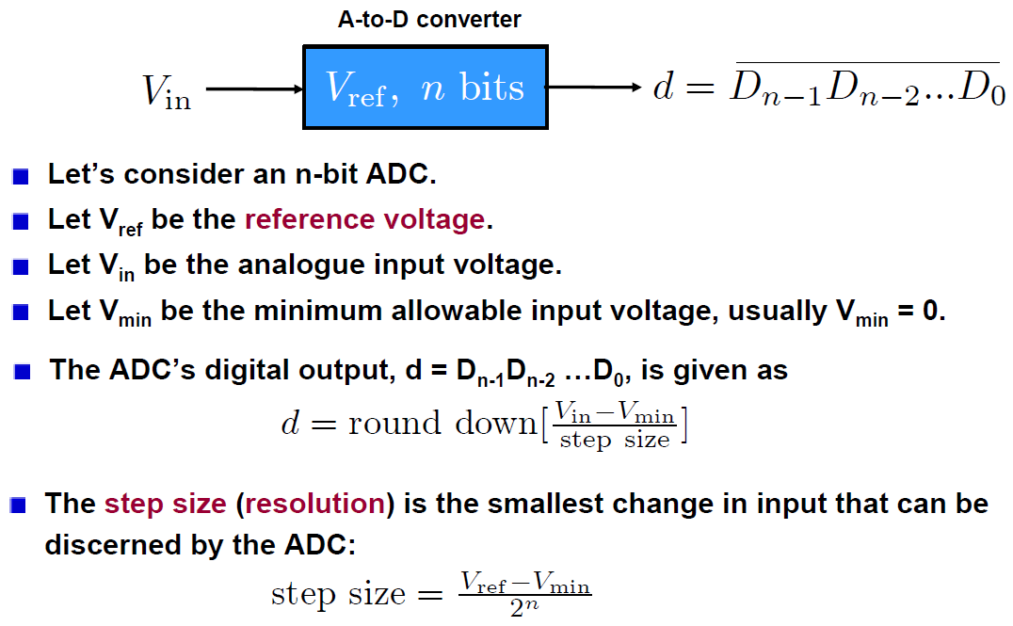
QUANTIZING THE SAMPLED SIGNAL

Slide 11
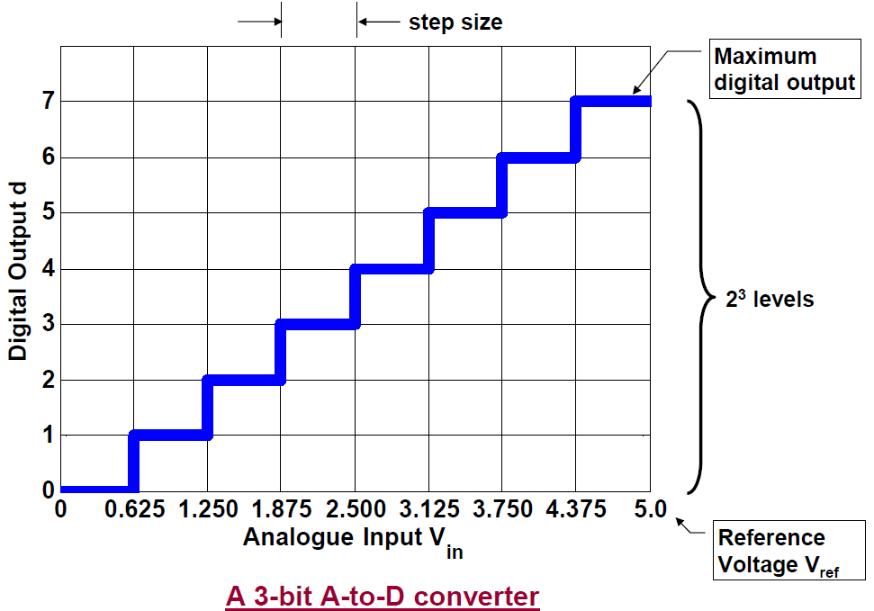
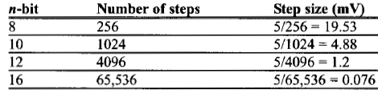
QUANTIZING THE SAMPLED SIGNAL

Slide 12
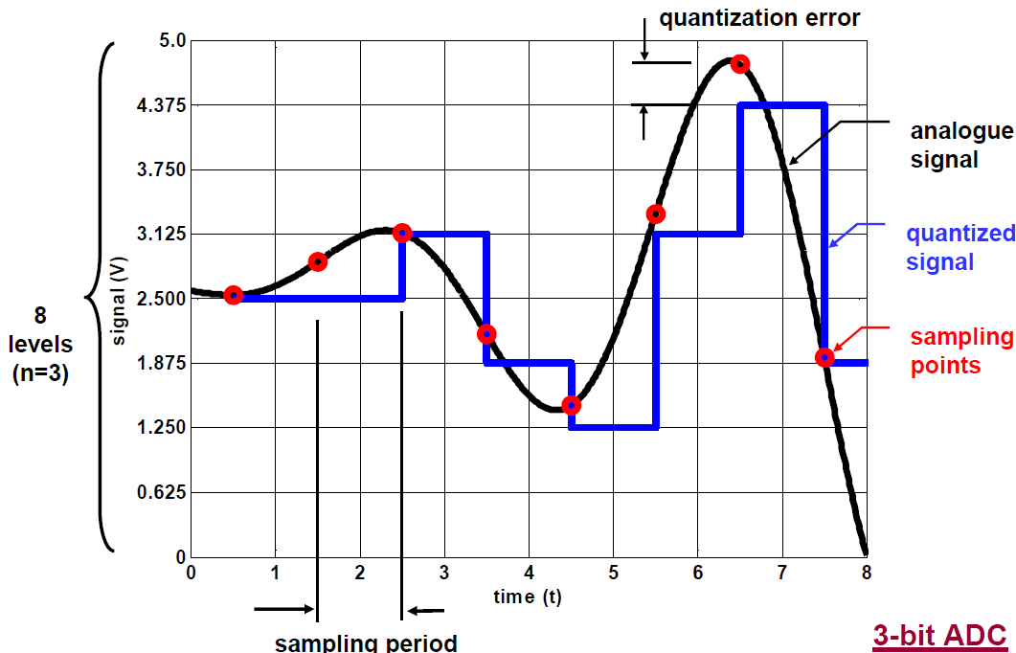
QUANTIZING THE SAMPLED SIGNAL
111
100
011
5v / 8 = 0.625
010
001
000

Slide 13
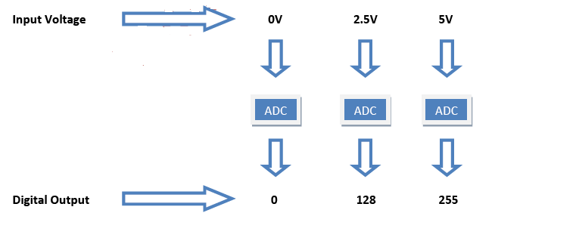
8-BIT ADC

Slide 14
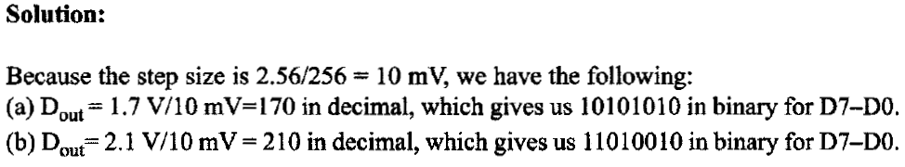
EXAMPLE

Slide 15
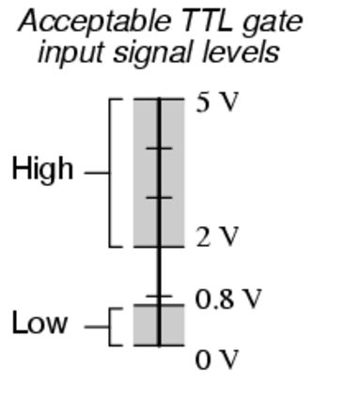
A QUESTION
What is the difference between an ADC and a digital input pin?

Slide 16
THE ADC IN ATMEGA32
The ADC has a 10-bit resolution.
The binary output has n = 10 bits
The ADC has 8 input channels
Analogue input can come from 8 different sources
However, it performs conversion on only one channel at a time
If default reference voltage V_{ref} = 5V is used
step size: 5 V/1024 = 4.88mV
The clock rate of the ADC can be different from the CPU clock rate
One ADC conversion takes 13 ADC cycles
An ADC prescaler will decide the ADC clock rate

Slide 17
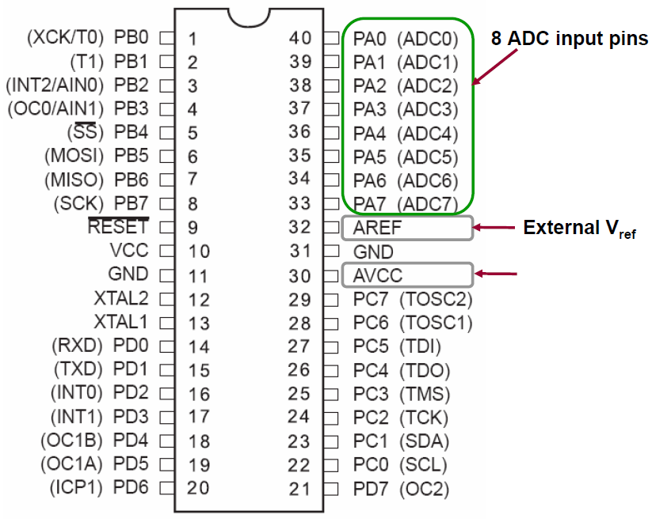
RELEVANT PINS

Slide 18
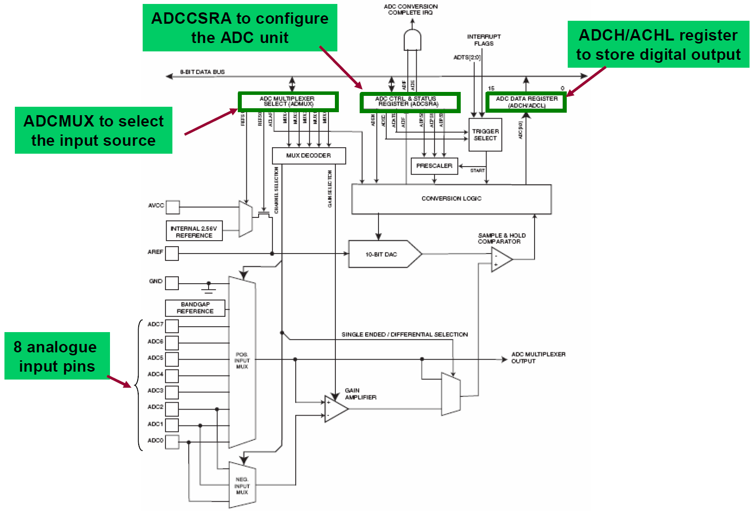
BLOCK DIAGRAM
ADCSRA
ADMUX
A Sample and Hold circuit
Making sure input voltage is constant during conversion

Slide 19
MAIN ASPECTS
What are the relevant ADC registers?
ADMUX
ADCH/ADCL
ADCSRA
SFIOR
What are the steps to use the ADC?
How to use ADC interrupt?

Slide 20
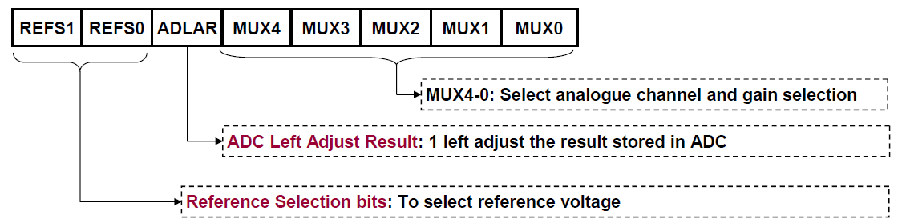
ADC MULTIPLEXER SELECTION REGISTER (ADMUX)

Slide 21
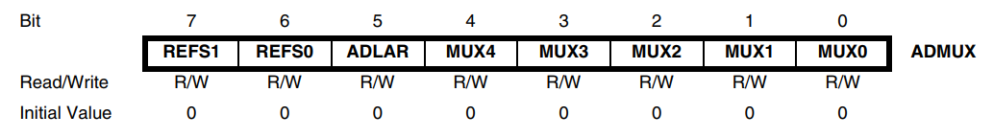
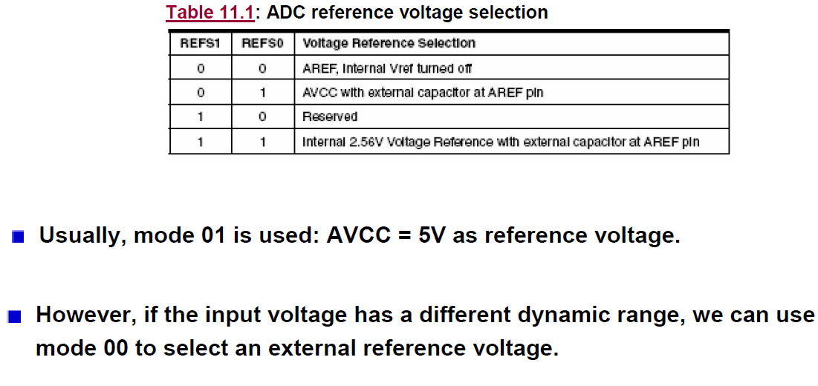
SELECTING REFERENCE VOLTAGE V_{REF}
AVCC must not differ more than ±0.3V from VCC.

Slide 22
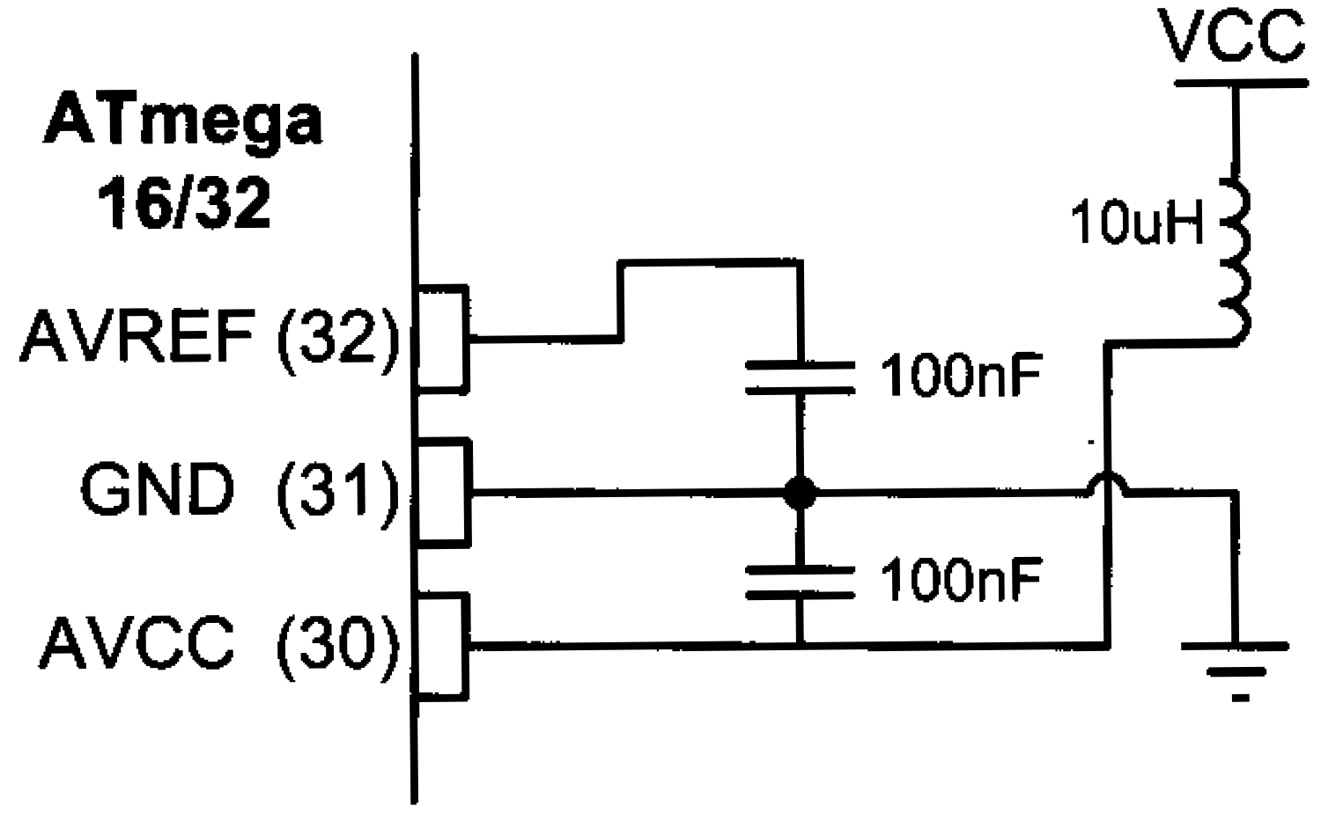
ADC RECOMMENDED CONNECTION for Vref = AVCC
https://electronics.stackexchange.com/questions/86207/atmega8-why-do-vcc-and-avcc-have-to-be-connected

Slide 23
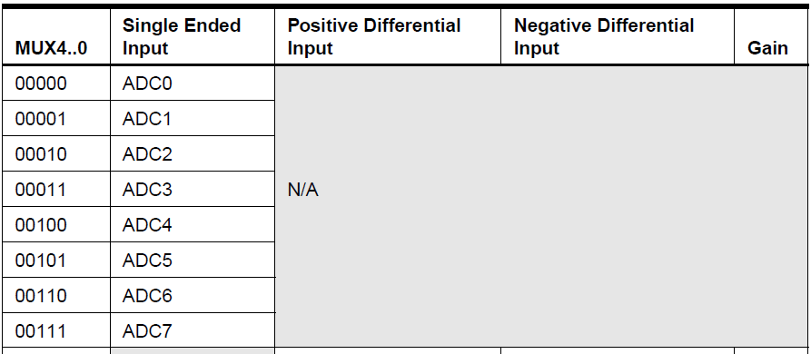
SELECTING INPUT SOURCE

Slide 24
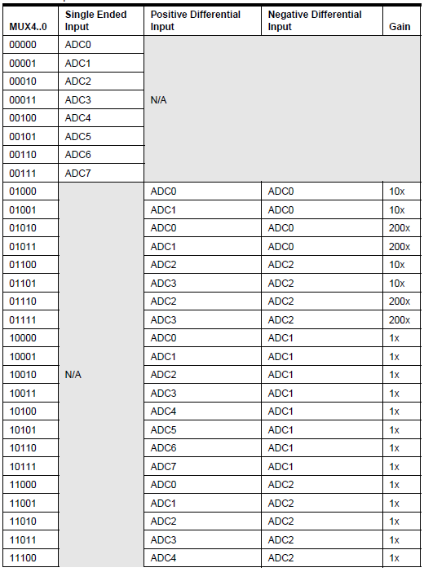
SELECTING INPUT SOURCE
Why select same ADC source as both positive input and negative input?
https://www.avrfreaks.net/forum/pos-differential-input-neg-differential-input

Slide 25
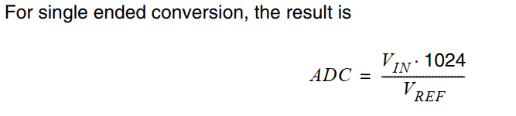
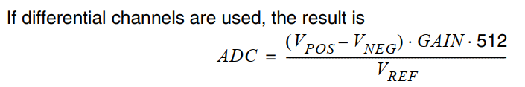
ADC Output
Differential ADC is presented in two’s complement form, from 0x200 (-512d) through 0x1FF (+511d).

Slide 26
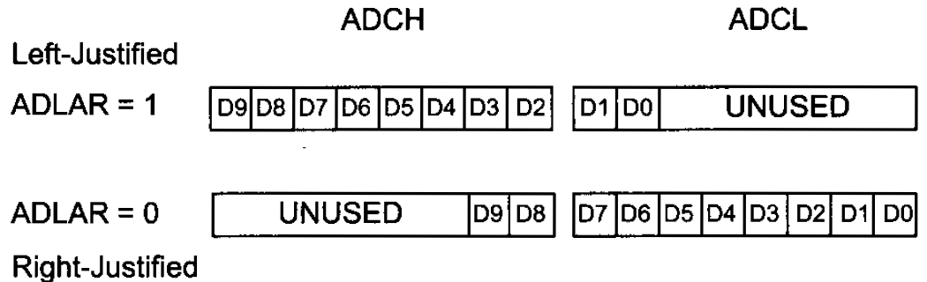
ADCH & ADCL REGISTERS
Why two separate registers?
Fast read of only one register with a bit of sacrifice on accuracy.
What is the maximum error while reading only ADCH with ADLAR=1?

Slide 27
Read ADCL Before ADCH
ADCL must be read first, then ADCH, to ensure that the content of the Data Registers belongs to the same conversion.
Once ADCL is read, ADC access to Data Registers is blocked, i.e. value of ADCL and ADCH will not be changed until ADCH is read.
This means that if ADCL has been read, and a conversion completes before ADCH is read, neither register is updated and the result from the conversion is lost.
When ADCH is read, ADC access to the ADCH and ADCL Registers is re-enabled.

Slide 28
Read ADCL Before ADCH
Can you read only ADCH?
Can you read only ADCL?

Slide 29
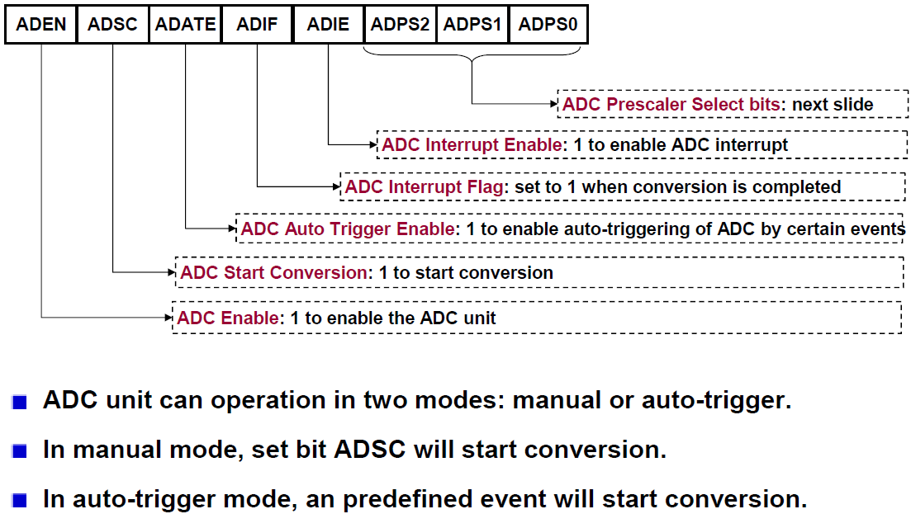
ADC CONTROL AND STATUS REGISTER (ADCSRA)

Slide 30
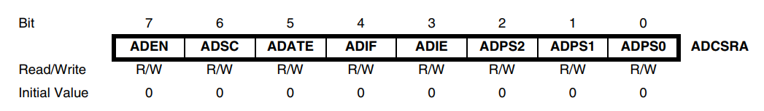
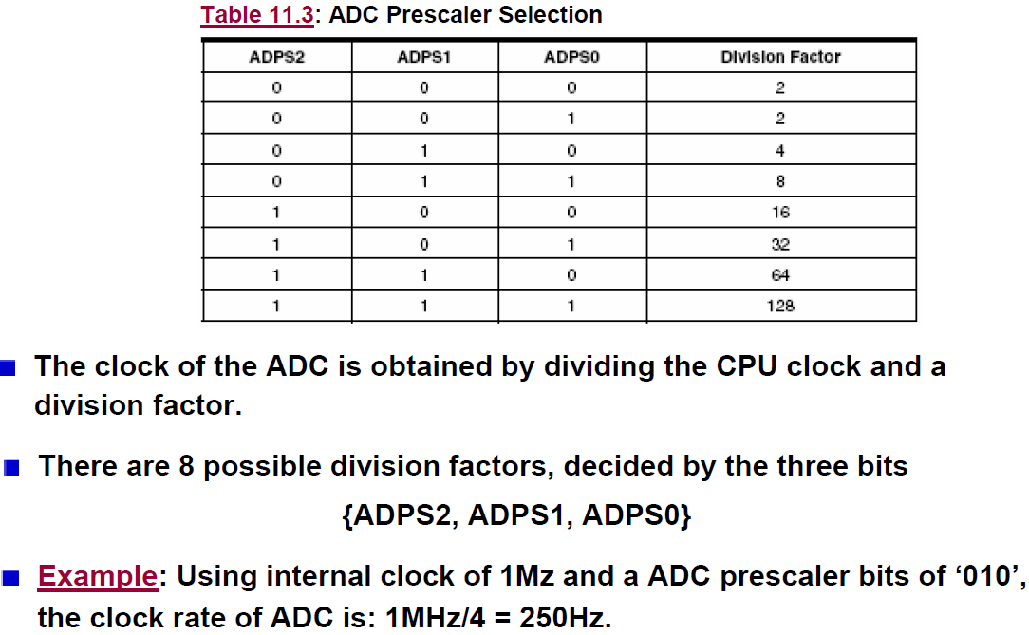
ADC CLOCK
250KHz

Slide 31
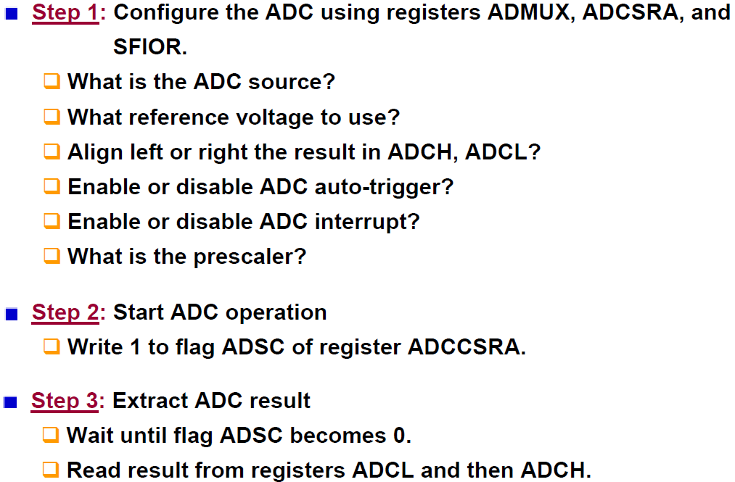
STEPS TO USE THE ADC

Slide 32
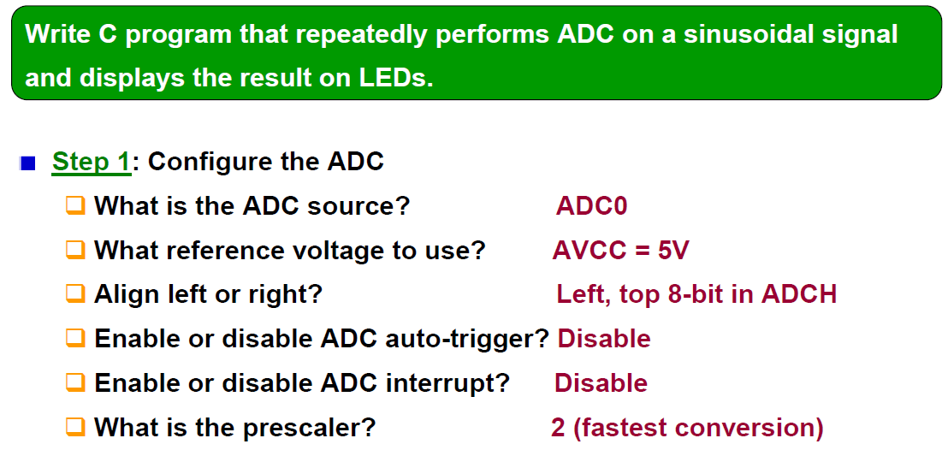
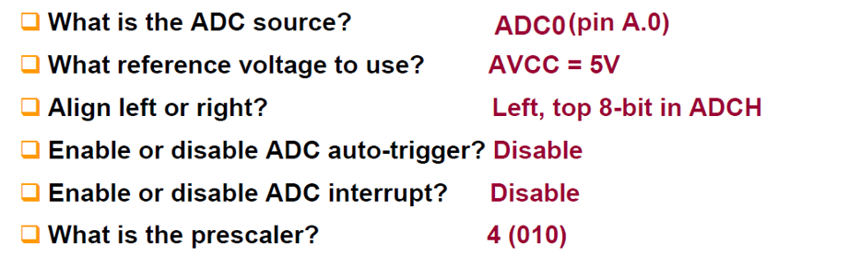
SIMPLE EXAMPLE

Slide 33
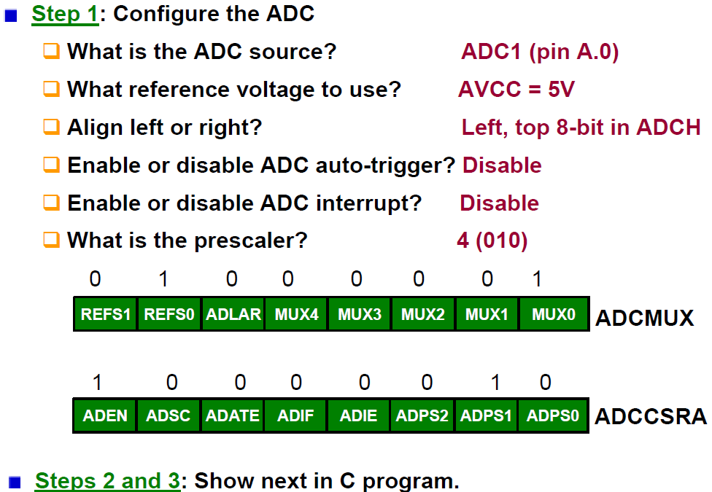



SIMPLE EXAMPLE

Slide 34
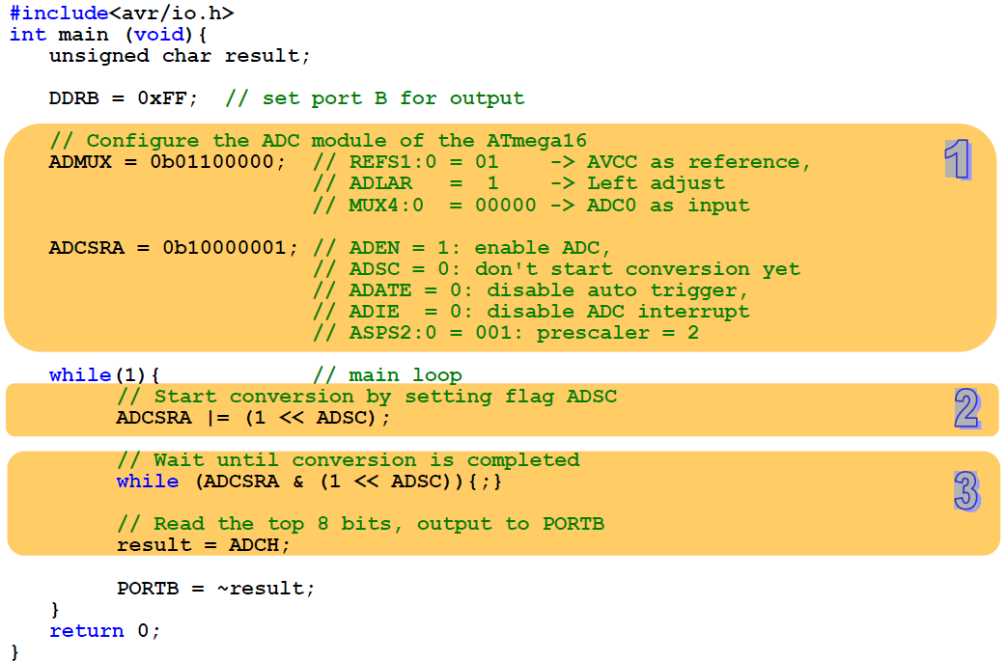
What if you want to do some other work while ADC going on?
float voltage = (result << 2) * 5 / 1024;

Slide 35
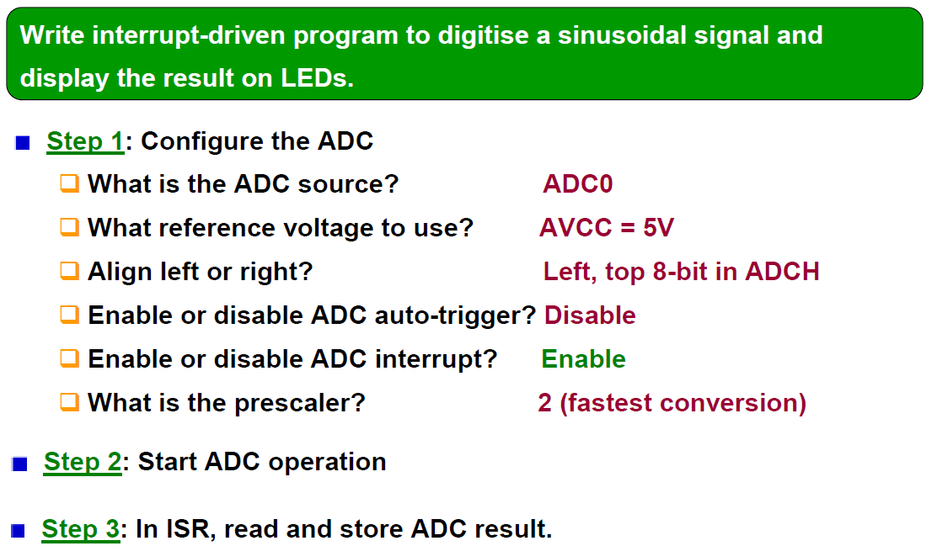
SIMPLE EXAMPLE: USING ADC INTERRUPT

Slide 36
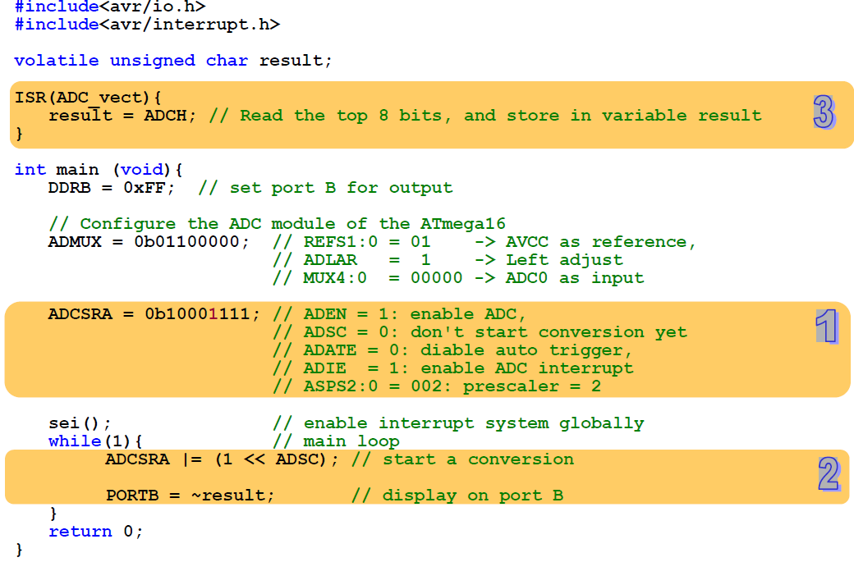

Slide 37
Measuring Temperature using LM35 Sensor

Slide 38
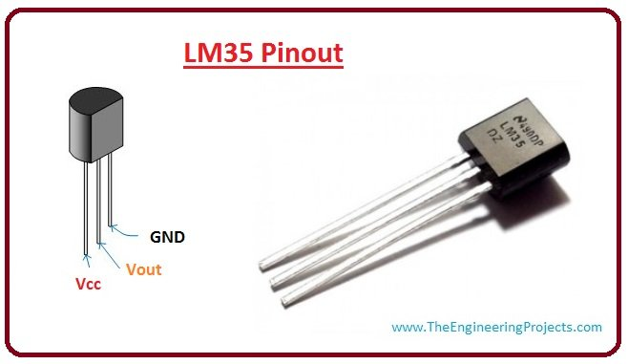
LM35
10mV/°C

Slide 39
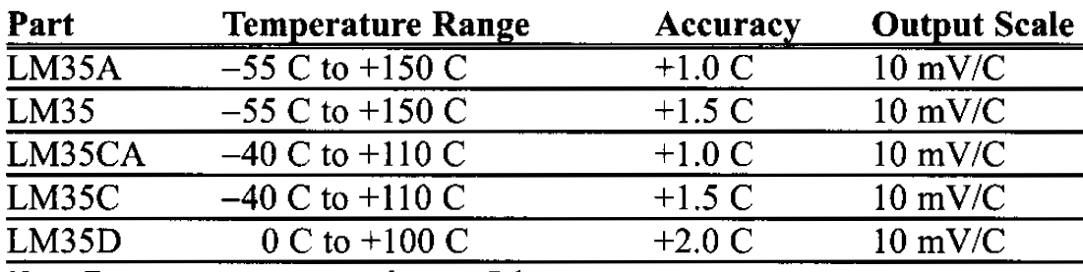
TEMPERATURE SENSOR

Slide 40
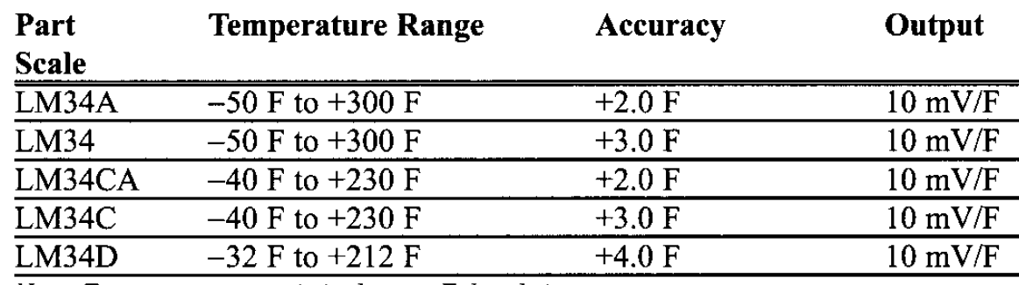
TEMPERATURE SENSOR

Slide 41
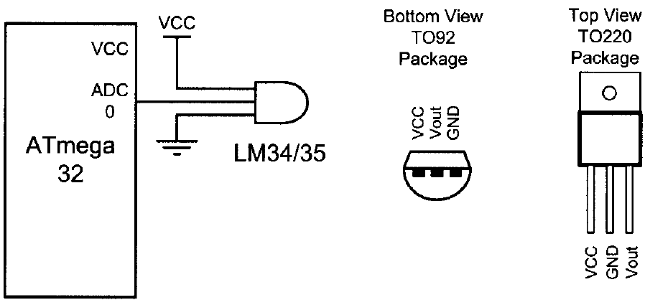
INTERFACING LM34 TO AVR

Slide 42
INTERFACING LM35 TO AVR
If we use the internal 2.56 V reference voltage
step size would be 2.56 V/1024 = 2.5 mV
This makes the binary output of the ADC four times the real temperature
Divide the binary output by 4 to get the real temperature
Step size = 2.56 / 1024
Volt = Stepsize * ADC
Mv = volt * 1000
Temp = Mv / 10
Temp = (2.56 / 1014) * ADC * 1000 / 10 = 0.25 * ADC = ADC / 4 ~ ADC >> 2
(2.56 * 1000) / (1024 * 10) = 0.25 = 1/4

Slide 43
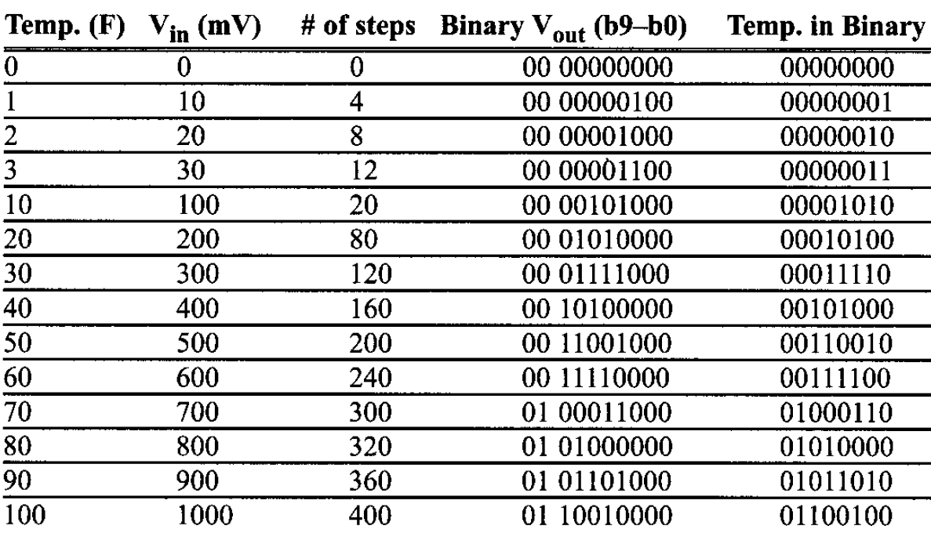
INTERFACING LM34 TO AVR

Slide 44
INTERFACING LM34 TO AVR
#include <avr/io.h> //standard AVR header
int main (void)
{
DDRB = 0xFF; //make Port B an output
ADCSRA = 0x87; //make ADC enable and select ck/128
ADMUX = 0xE0; //2.56 V V_{ref} and ADCO single-ended
//data will be left-justified
while (1 ){
ADCSRA |= (l<<ADSC); //start conversion
while((ADCSRA & (l<<ADIF))==0); //wait for end of conversion
PORTB = ADCH; //give the high byte to PORTB
}
return 0;
}

Slide 45
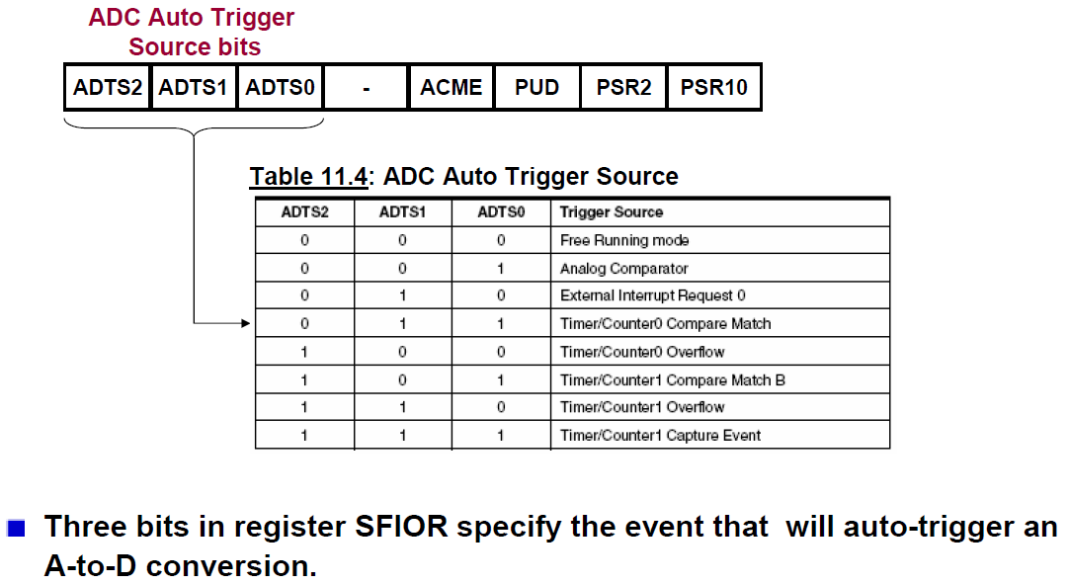
SPECIAL FUNCTION IO REGISTER (SFIOR)

Slide 46
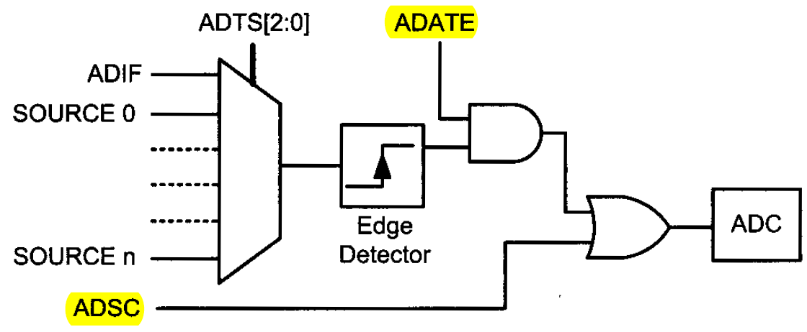
AUTO TRIGGER LOGIC

Slide 47
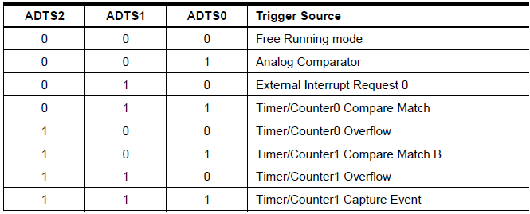
AUTO TRIGGER SOURCE

Slide 48
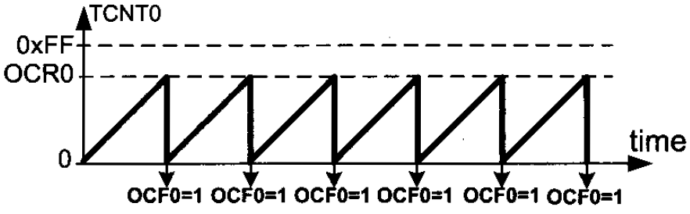
TIMER: NORMAL VS. CTC MODE

Slide 49
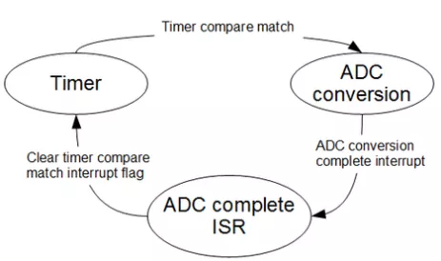
A PRACTICAL PROBLEM
We need to sample an analog signal @ 20 kHz sampling frequency
The only way to do this correctly
use auto-triggering with exact time intervals
Let’s see how can we do this using Timer0

Slide 50
SOLUTION OVERVIEW
Assume
system clock frequency = 16 MHz
Timer0 prescaler = 8
To ensure 20 kHz sampling frequency
Time between successive ADC conversions?
50us
Use Timer0 to trigger ADC every 50us
How to trigger Timer0 compare match every 50us?
Need to count?
50us/(8/16000000) = 100
From 0 to 99
Set OCR0 = 99

Slide 51
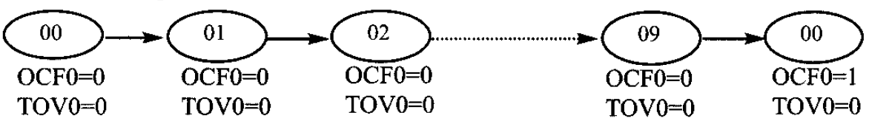
SOLUTION OVERVIEW
Timer0 compare match trigger every 50us
Need to count?
50us/(8/16000000) = 100
From 0 to 99
Set OCR0 = 99
Why 99 instead of 100 ?

Slide 52
SOLUTION OVERVIEW
Now let’s select ADC prescaler properly
ADC conversion must be completed before next Timer0 compare match occur
One auto triggered ADC conversion time takes 13.5 ADC cycles

Slide 53
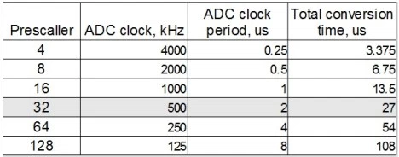
SOLUTION OVERVIEW
Now let’s select ADC prescaler properly
ADC conversion must be completed before next Timer0 compare match occur
One auto triggered ADC conversion time takes 13.5 ADC cycles

Slide 54
SOLUTION OVERVIEW
To fit in to 50us window we can select prescaller up to 32
Gives enough time to
Complete auto triggered ADC cycle
Clear Timer0 compare match flag
Store ADC value within one sample period
…

Slide 55
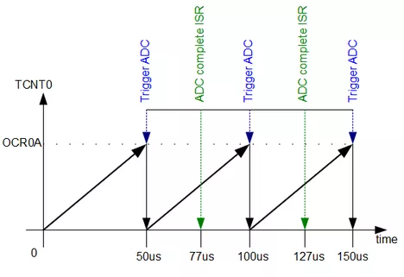
SOLUTION OVERVIEW
ADC prescaller = 32
Gives enough time to
Complete auto triggered ADC cycle
Clear Timer0 compare match flag
Store ADC value within one sample period
…

Slide 56
COMPLETE CODE FOR ATMEGA328
http://www.embedds.com/adc-on-atmega328-part-2/

